Slide 1
A tutorial for the single cell topological analysis (scTDA)
Quanhua Mu
Postdoctoral Fellow, HKUST

Slide 2
Outline
Introduction to single cell RNA sequencing
Introduction to scTDA (mapper)
Case study: human embryo development at single-cell resolution

Slide 3
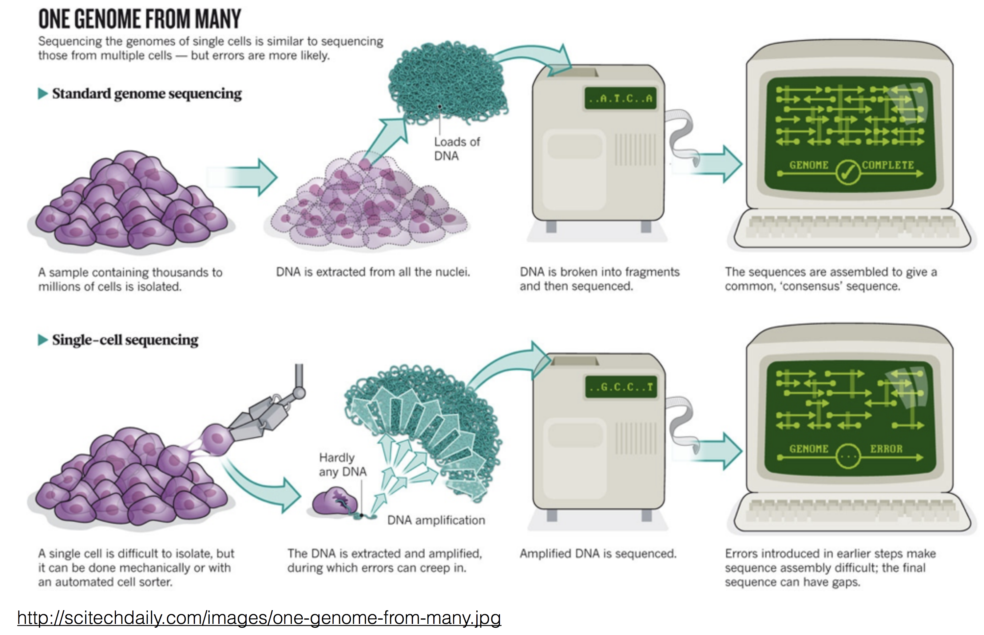
Single cell RNA sequencing (scRNA-seq)
Why single cell?
Remove ensemble average
Discover rare species
Reveal mechanisms
Standard RNA sequencing
RNA is extracted from all the cells and reverse-transcribed to cDNA
cDNA
“Bulk” RNA-seq data
“bulk”
Single cell RNA sequencing
RNA
“single-cell”
Reverse transcription and cDNA amplification
RNA is
Aplified cDNA is sequenced
Single-cell RNA-seq data

Slide 4
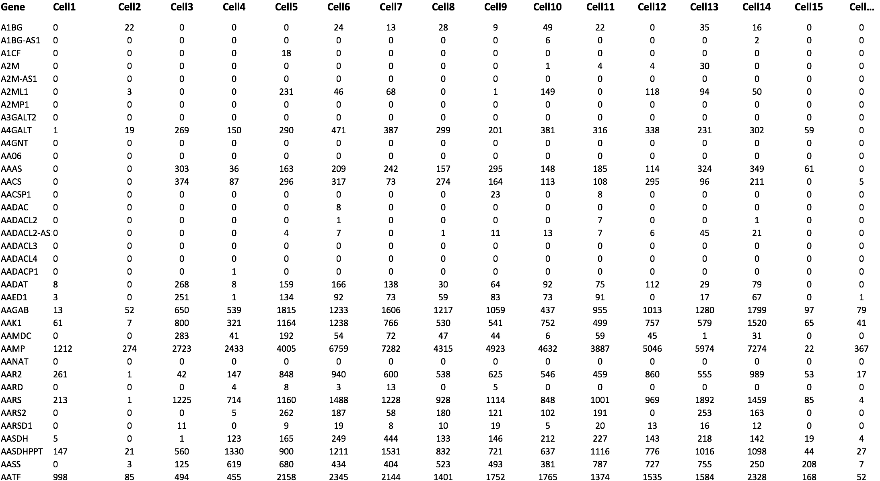
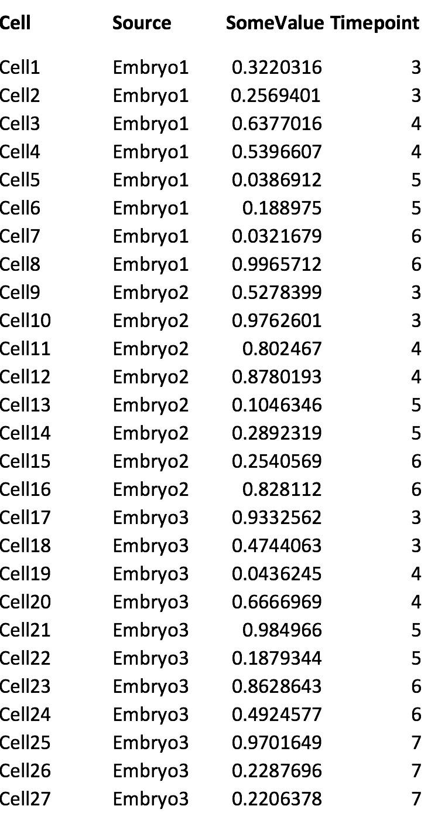
scRNA-seq data
1000s of cells
1000s of genes
A screenshot of the scRNA-seq data
Annotation data of the cells

Slide 5
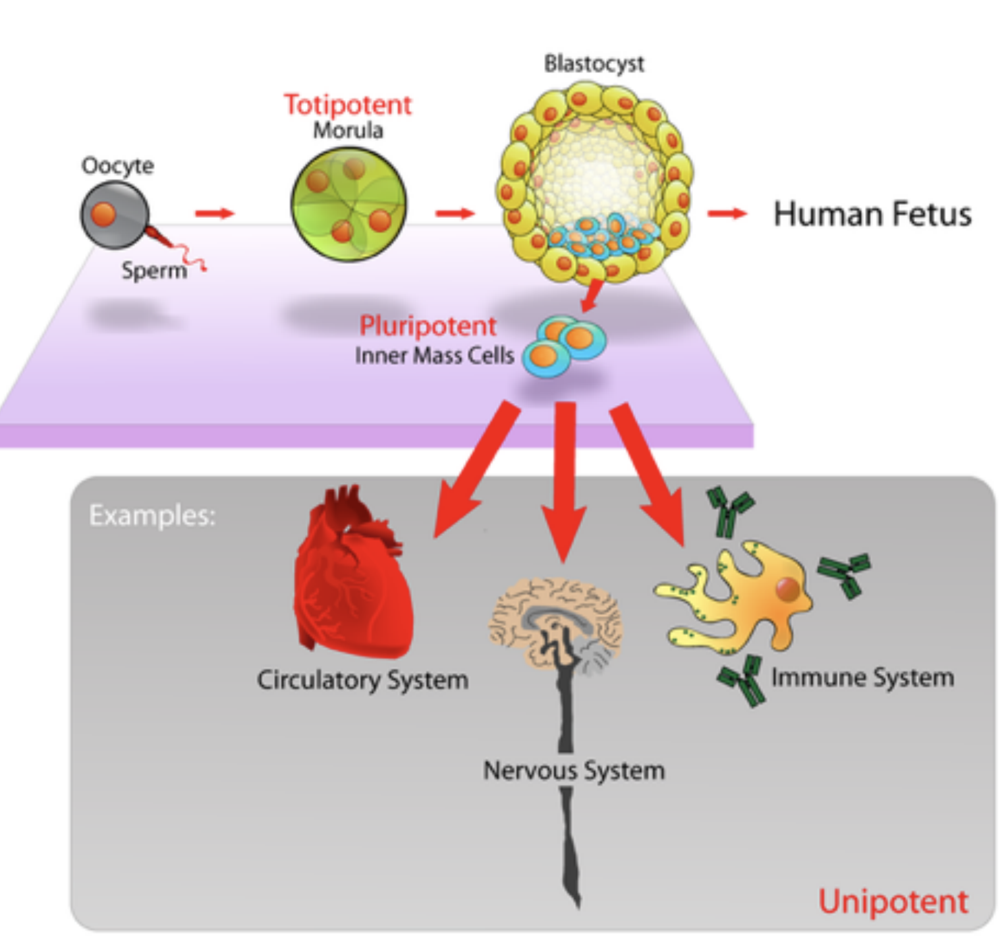
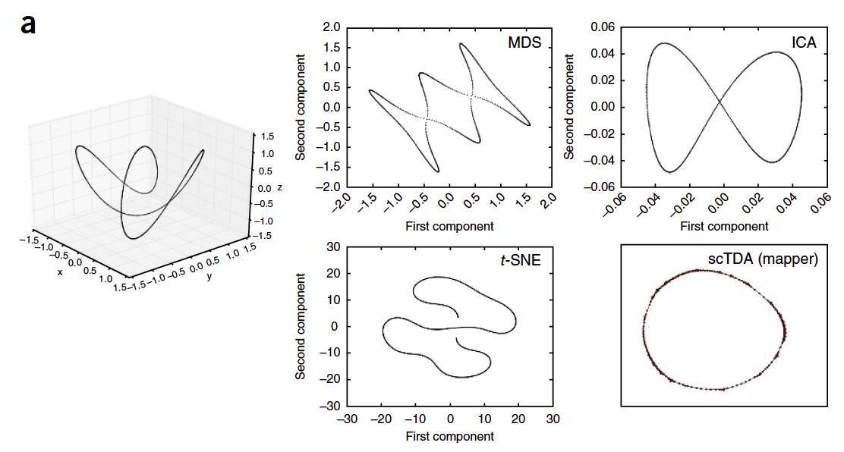
single cell topological analysis (scTDA)
Biological problem: to reveal the developmental trajectories of the single cells
Mathematical definition: to perform dimensional reduction while preserving the continuous relationship in high dimensions
Rizvi et al, Nat Biotech 2017

Slide 6
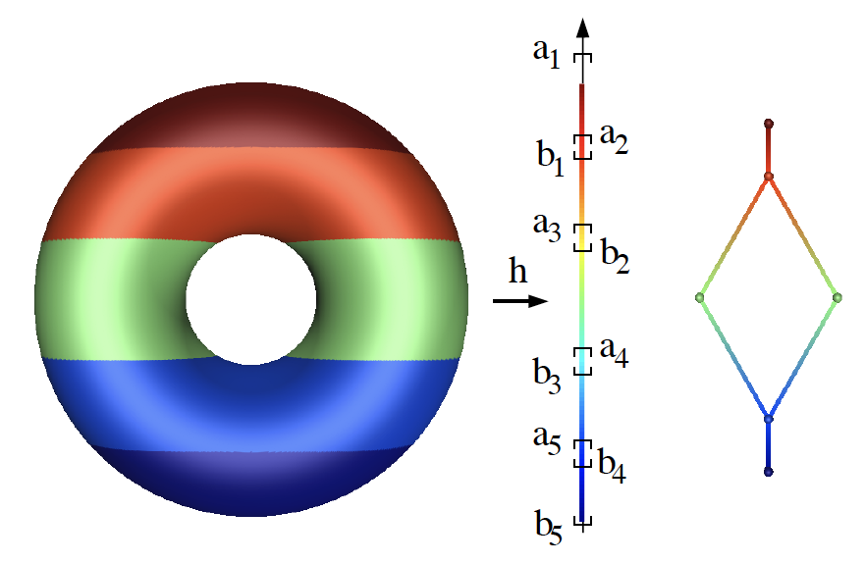
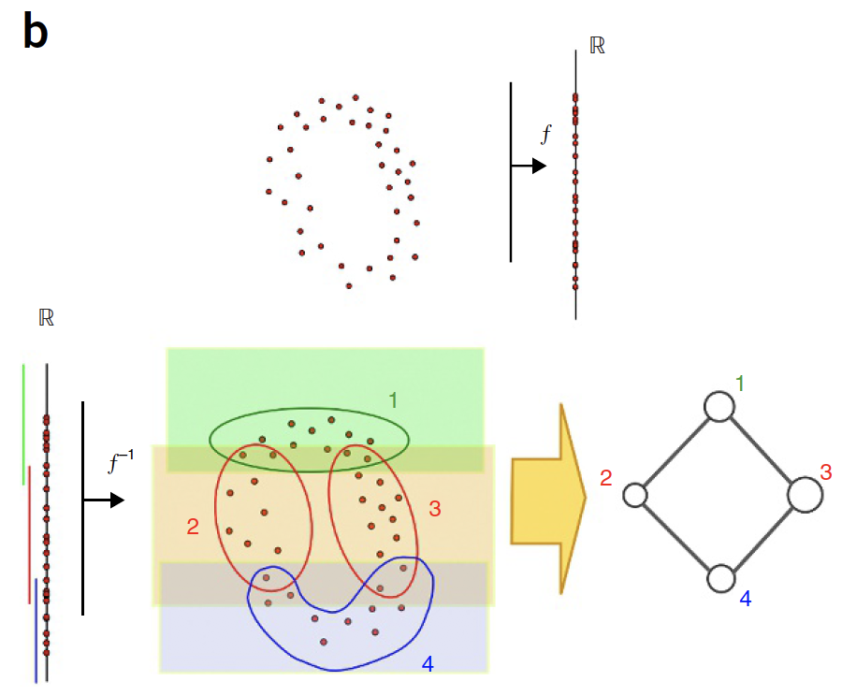
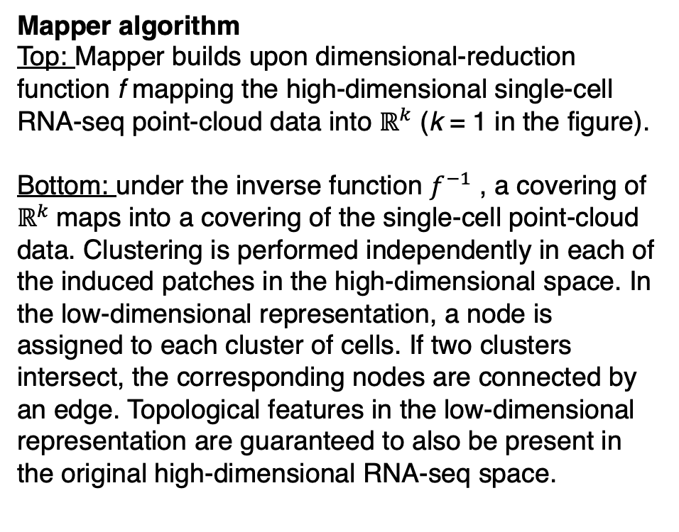
scTDA and the Mapper algorithm
scTDA is essentially based on the Mapper algorithm
Mapper algorithm
Top: Mapper builds upon dimensional-reduction function f mapping the high-dimensional single-cell RNA-seq point-cloud data into $ℝ^{k}$ (k = 1 in the figure).
Bottom: under the inverse function $f^{−1}$ , a covering of $ℝ^{k}$maps into a covering of the single-cell point-cloud data. Clustering is performed independently in each of the induced patches in the high-dimensional space. In the low-dimensional representation, a node is assigned to each cluster of cells. If two clusters intersect, the corresponding nodes are connected by an edge. Topological features in the low-dimensional representation are guaranteed to also be present in the original high-dimensional RNA-seq space.
Adopted from Prof Yao’s course slides and Rizvi et al, Nat Biotech 2017

Slide 7
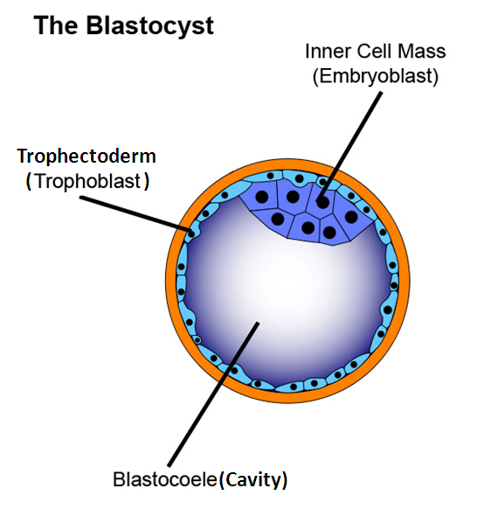
Case study: Human embryo development
 | E3 | E4 | E5 | E6 | E7 | Total
Embryos | 13 | 16 | 24 | 18 | 18 | 88
Cells | 81 | 190 | 377 | 415 | 466 | 1529
Petropoulos, Sophie, et al. "Single-cell RNA-seq reveals lineage and X chromosome dynamics in human preimplantation embryos." Cell 165.4 (2016): 1012-1026.

Slide 8
Case study: Human embryo development
Data preparing and cleaning
- Mapping to reference genome, counting mapped reads for each gene
- Removing cells with low sequencing depth and low mappability

Slide 9
Case study: Human embryo development
Filter cells

Slide 10
Case study: Human embryo development
Filter genes:
- select genes with relatively high expression, and high variability
195 genes selected (1%)
p.select_genes(avg_counts=2.0, min_z=3.0)

Slide 11
Case study: Human embryo development
Dimensional reduction by PCA
PC2
PC1

Slide 12
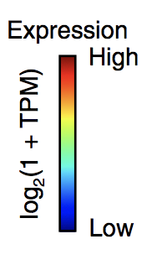
Case study: Human embryo development
Topological representation based on PC1 & PC2 using Mapper
- Parameter: 25 x 25 bins with an average of 40% overlap, unrooted
PDGFRA
Visualisition of the network may change.

Slide 13
Case study: Human embryo development
Topological representation based on PC1 & PC2 using Mapper
- Parameter: 25 x 25 bins with an average of 40% overlap, rooted
DPPA
c = scTDA.RootedGraph(‘Embryo_mds’, ‘Embryo.no_subsampling.tsv’, posgl=True); c.draw('DPPA5');

Slide 14
Case study: Human embryo development
TDA correctly reproduces the differentiation time course
Late
Embryo day
Early
Time

Slide 15
Case study: Human embryo development
Pseudo-timing based on the topological representation
High
Low
Distance
Root node

Slide 16
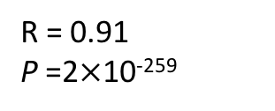
Case study: Human embryo development
Pseudo-time based on the topological representation
R = 0.91
P =2$×$10⁻²⁵⁹

Slide 17
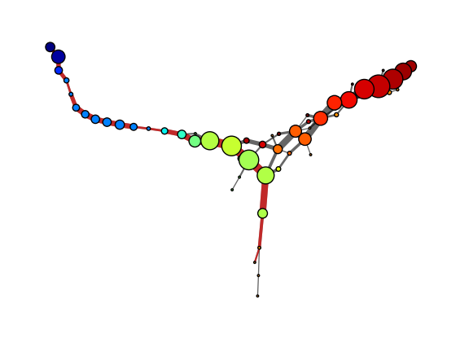
Case study: Human embryo development
Skeleton of the network captures the differentiation process
Late
Red path: the inner cell mass
Gray path: trophectoderm
Embryo day
Early
Time
c.draw_skeleton(‘timepoint', markpath=True);

Slide 18
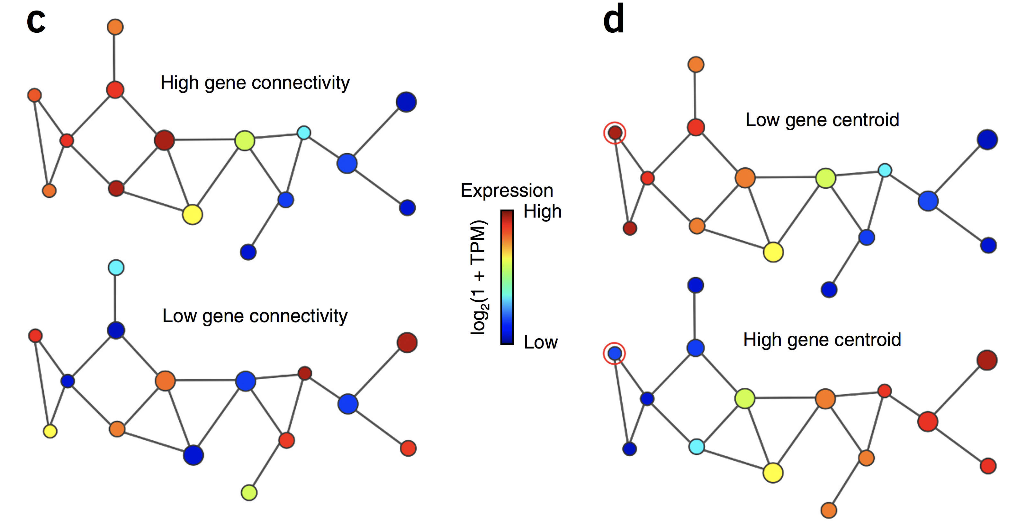
Case study: Human embryo development
Connectivity and centroid

Slide 19
Case study: Human embryo development
Transient cellular states identified based on centroid and dispersion
Transient state 1
Transient state 2
Transient state 3
Root node

Slide 20
Reference and links
scTDA: https://github.com/RabadanLab/scTDA
Tutorial: https://www.dropbox.com/s/ma80a641miteyxf/scTDA%20Tutorial.tar.gz?dl=1
Methods: https://www.nature.com/articles/nbt.3854.pdf
Dataset: https://www.cell.com/fulltext/S0092-8674(16)30280-X

Slide 21
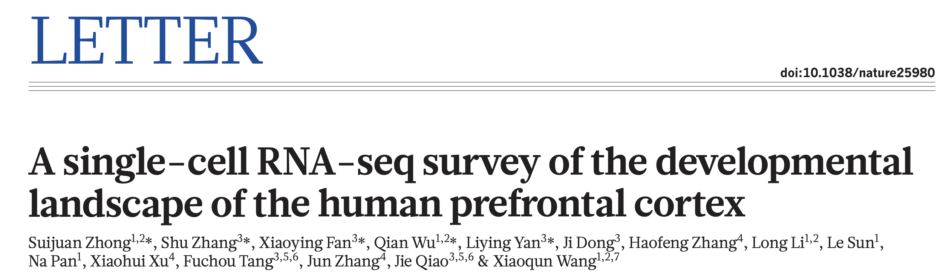
Proposed data for course project using scTDA
Zhong et al, Nature 2018

Slide 22
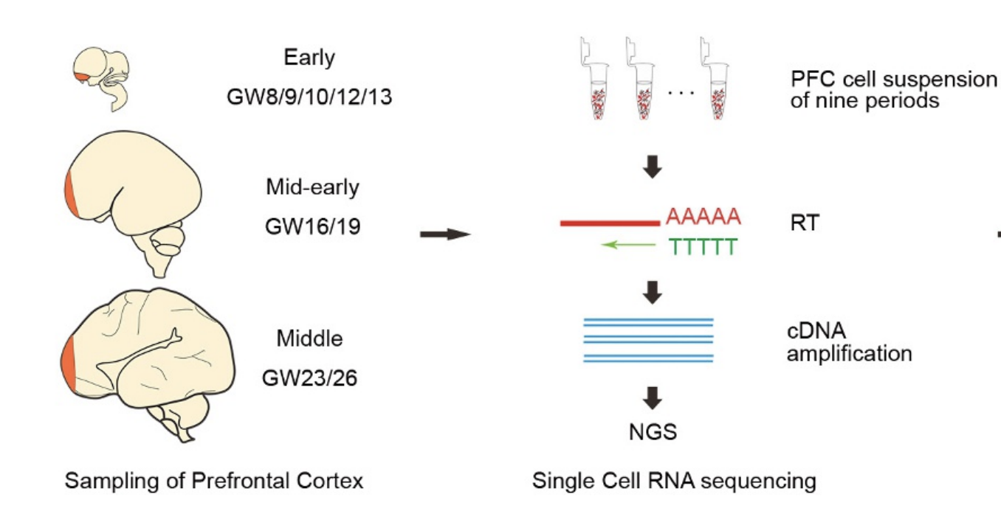
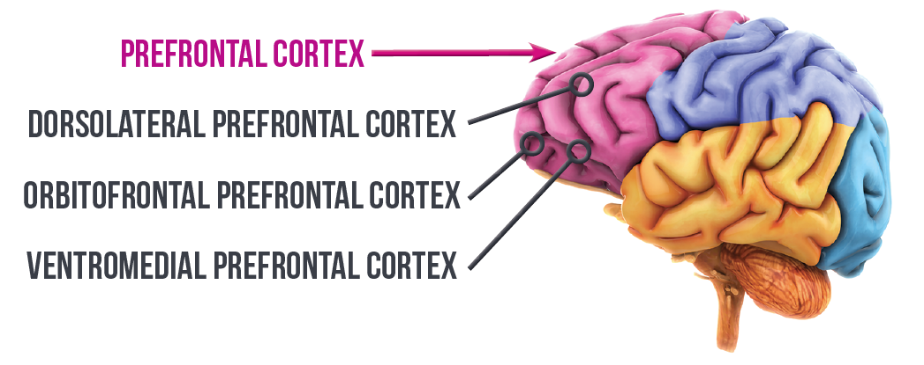
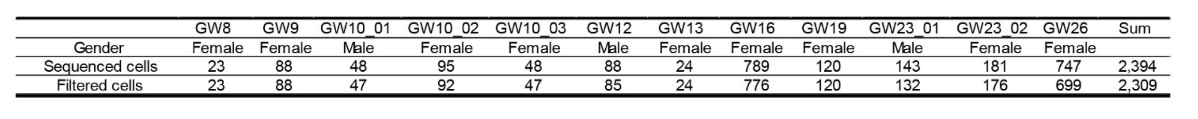
Sample and data information
PFC: prefrontal cortex; GW: gestational week; RT: reverse transcription
Zhong et al, Nature 2018

Slide 23
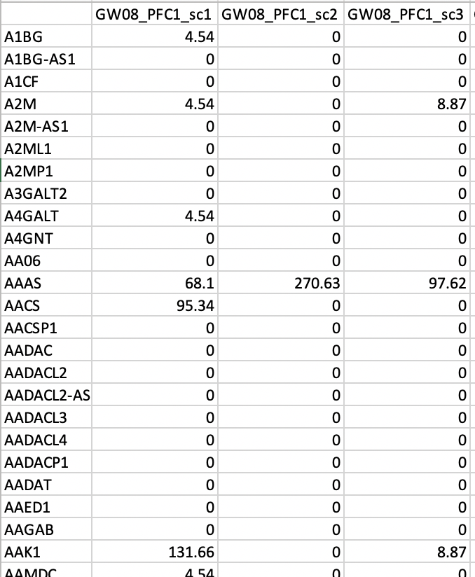
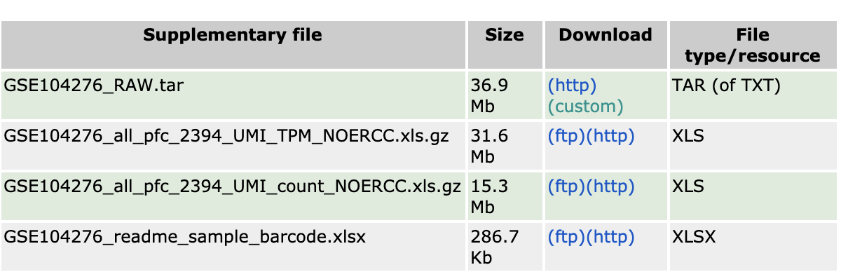
Preview of the scRNA-seq data
https://www.ncbi.nlm.nih.gov/geo/query/acc.cgi?acc=GSE104276

Slide 24
Acknowledgement
The tissue donors
The data generators

